Slide 1
Demographics and its effects on the Canadian rental market
Project 1
Submitted by:
Evan Hollinshead, Ankit Mukherjee, Eleshia Hall, Ricky Zhou, Abdullah Ar Rafi

Slide 2
Main Question
Is there a linear relationship between population and renting in Ontario in the last 30 years (1991-2021)?

Slide 3
Research Questions
How does birth rate affect the increase/decrease in renting homes?
How has income and rent changed over the past 30 years?
How has immigration affected renting factors?
Who is renting and does divorce impact renting in Canada?

Slide 4
Birth Rate
Question:
How does the birth rate affect the increase/decrease in renting homes?
Response:
One of the first areas we wanted to look at was “Birth rate”. This ended up being a bit of a dead end as any of our comparisons didn’t seem to draw any direct conclusions. However, it does suggest that as renting prices go up and space becomes more limited. The Birth rate is more likely to continue its downward trajectory. One of the biggest costs to having children is housing. As of 2011 the homeownership rate is beginning to decline. Therefore increasing the dependency on renting.

Slide 5
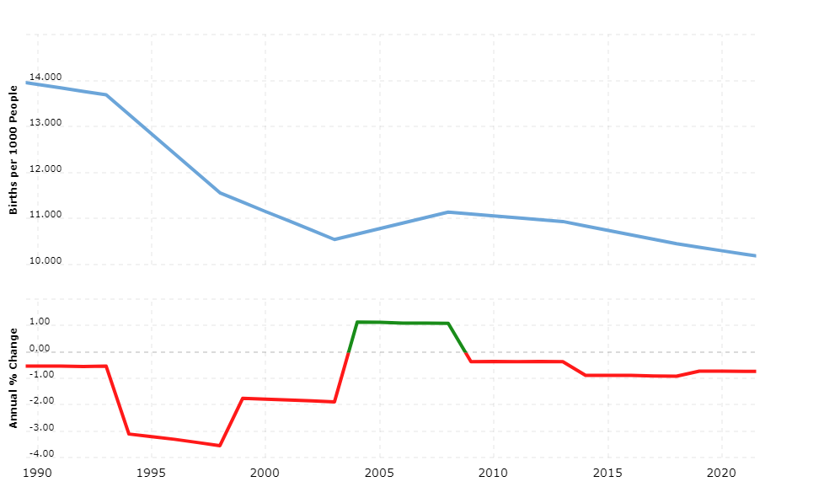
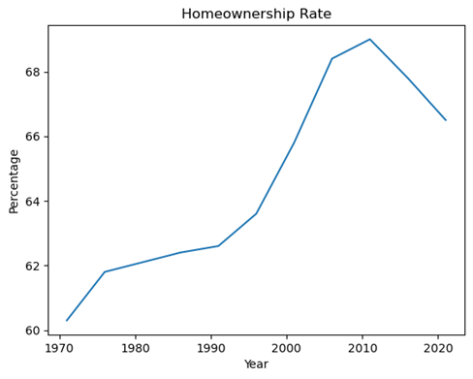
Birth Rate - Analysis

Slide 6
Economic Indicators
Question: Income versus renting, and how that has changed over the last 30 years?
Response:
Income has steadily risen along with the cost of Rent, but there's more to consider.
Income vs Rent vs Housing
Change in Rental Unit Pricing
Housing ownership behaviour

Slide 7
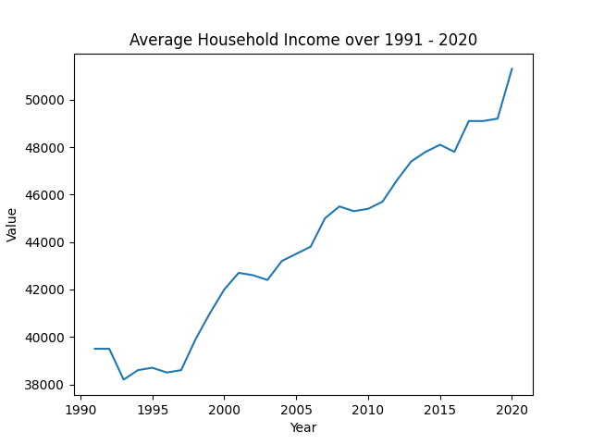
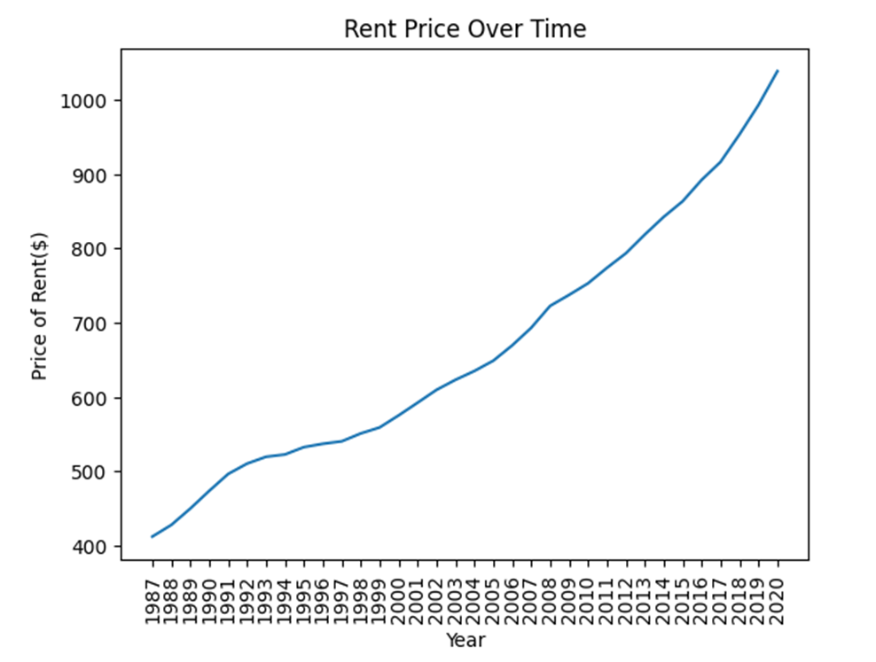
Economic Indicators: Income v Rent Price

Slide 8
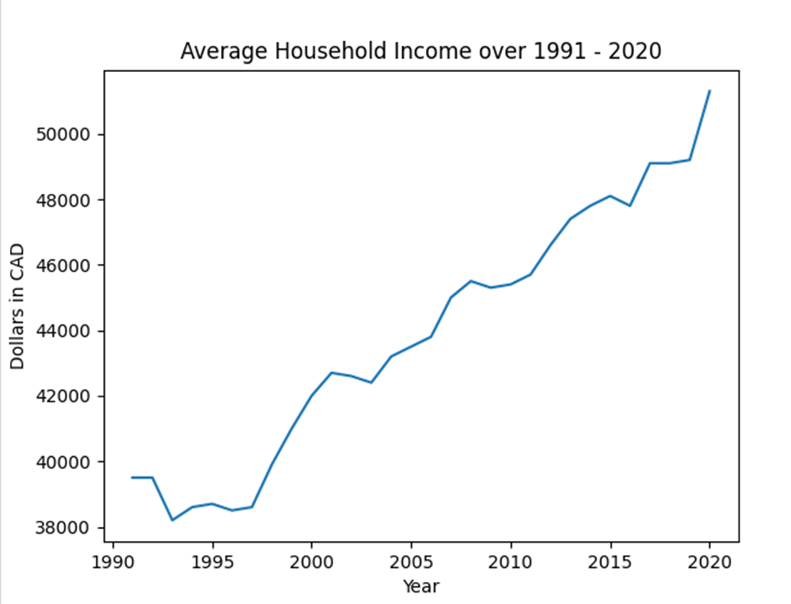
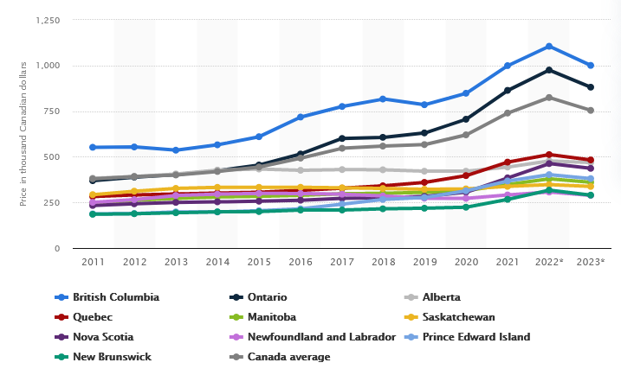
Economic Indicators: Income v Housing Prices
Average resale house prices in Canada from 2011 to 2021 with a forecast up to 2023 with, by province (in 1,000 Canadian dollars)
Statista. (2021). Average house prices in Canada as of March 2021, by province
(in Canadian dollars) [Graph]. In Statista. Retrieved April 12, 2023,
From
https://www.statista.com/statistics/587661/average-house-prices-canada-by-province/

Slide 9
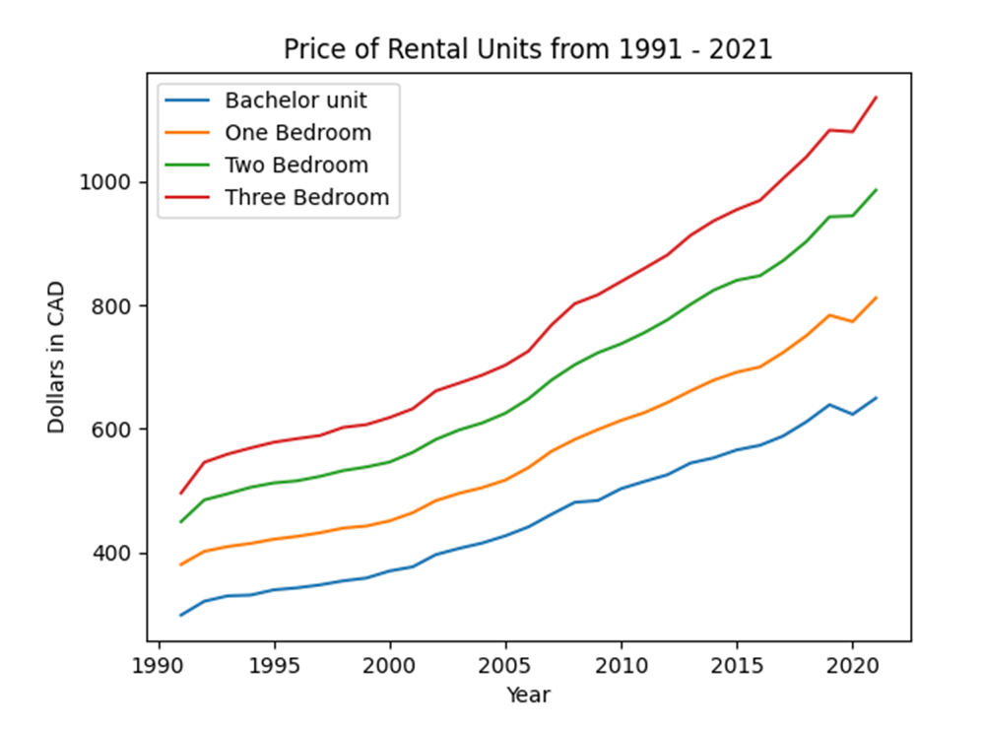
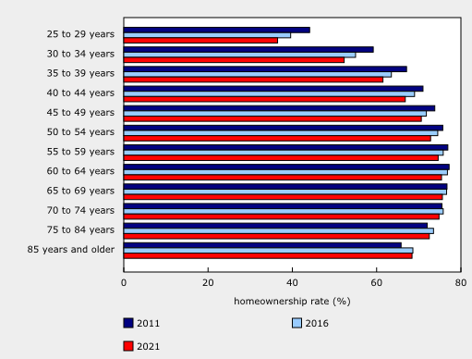
Economic Indicators: Changes in Rent Units vs Homeownership rates
Homeownership (%) among age demographics in 2011,2016,2021
Statistics Canada. (2022, September 21). Chart 2: Homeownership rates, by age
group, 1991 to 2021. [Graph]. In The Daily. https://www150.statcan.gc.ca/n1/daily-quotidien/220921/cg-b002-eng.htm

Slide 10
Immigration
Question: How has immigration affected renting factors? Are immigrants renting more or purchasing homes?
Response:
Most people immigrate from Europe and Asia
Most immigrants are renting

Slide 11
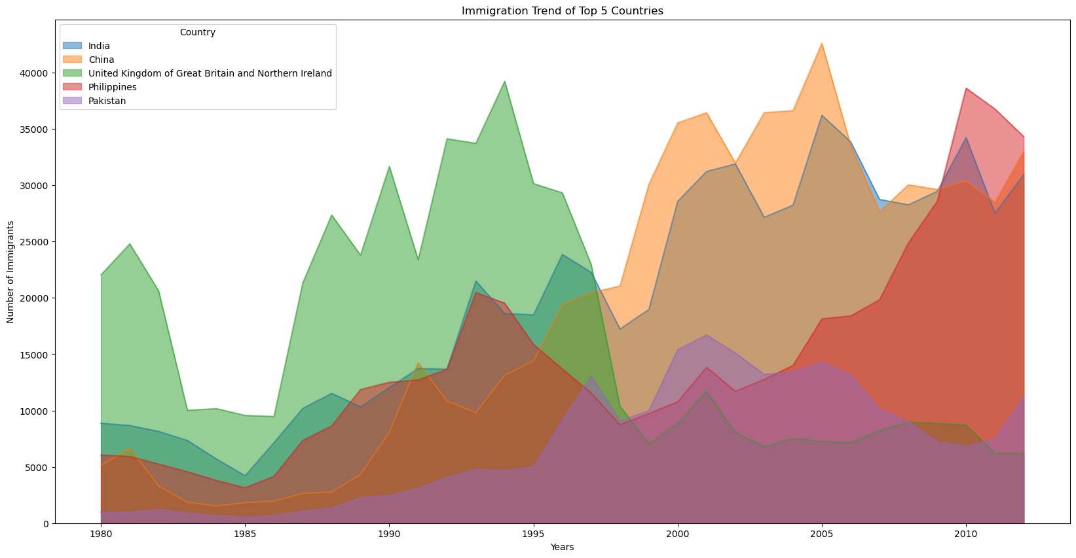
Immigration - Analysis

Slide 12
Family Structure
Question: Who is renting, and does divorce impact renting in Canada?
Response:
Families with one earner seem to be the ones that are more likely to rent
Divorce on average has been on a steady increase, meaning more people in need to rent

Slide 13
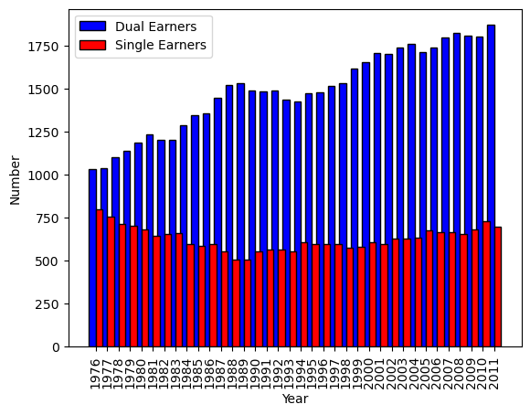
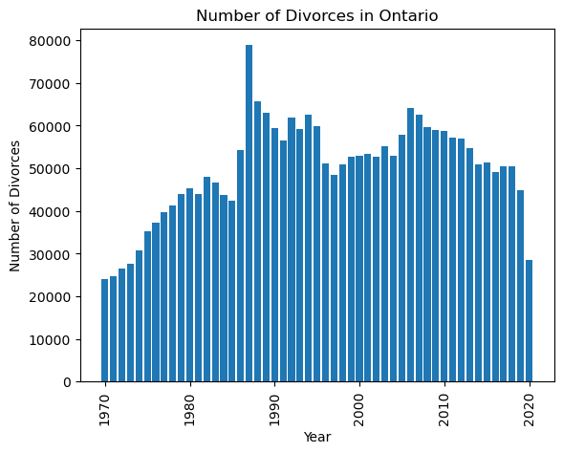
Family Structure - Analysis

Slide 14
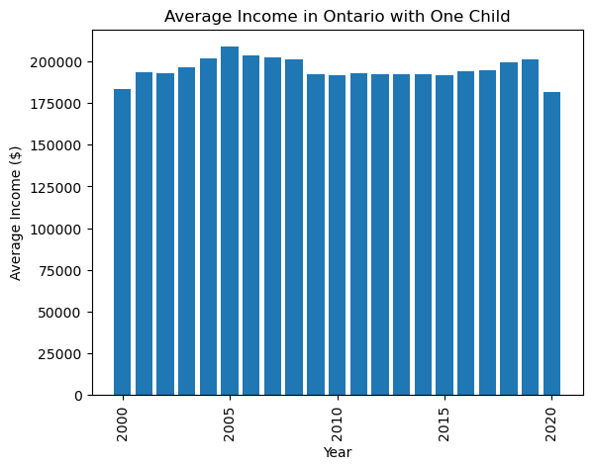
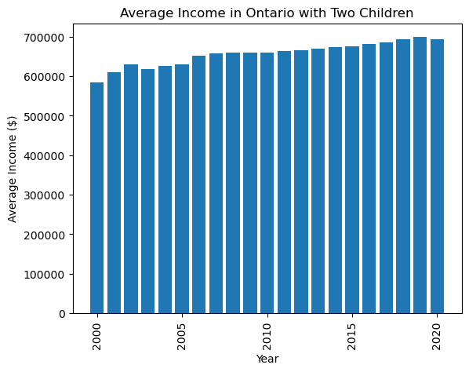

Family Structure - Analysis

Slide 15
Summary
Remember our question…
Is there a linear relationship between population and renting in Ontario in the last 30 years (1991-2021)?
With all of our data, we can summarize:
Declining Birth rates inverse relationship to renting
Homeownership has been declining, renting is increasingly more affordable in comparison
Despite declining birth rates, population growth has been stabilized through immigration.
The composition of family structure does not show any effects on the ability to rent

Slide 16
References
Ahmad, A. (2020). Immigration to Canada [Data set]. Kaggle.
https://www.kaggle.com/datasets/ammaraahmad/immigration-to-canada
Macrotrends. (n.d.). Canada population 1950-2022. Retrieved April 12, 2023, from
https://www.macrotrends.net/countries/CAN/canada/population
Statistics Canada. (2022). Table 11-10-0012-01 Population estimates on July 1st, by age and
Sex. Retrieved April 3, 2023, from
https://www150.statcan.gc.ca/t1/tbl1/en/tv.action?pid=1110001201
Statistics Canada. (2021). Residential property price index (RPPI), property type: rental apartments,
Canada, monthly (1146388B). Open Government Portal of Canada. https://open.canada.ca/data/en/dataset/1146388b-a150-4e70-98ec-eb40cb9083c8

Slide 17
References continued
Statista. (2021). Average house prices in Canada as of March 2021, by province (in Canadian
dollars) [Graph]. In Statista. Retrieved April 12, 2023, From
https://www.statista.com/statistics/587661/average-house-prices-canada-by-province/
Statistics Canada. (2022, September 21). Chart 2: Homeownership rates, by age group, 1991 to 2021.
[Graph]. In The Daily. https://www150.statcan.gc.ca/n1/daily-quotidien/220921/cg-b002-eng.htm
Statistics Canada. (2022, September 21). Chart 2: Homeownership rates, by age group, 1991 to 2021.
[Graph]. In The Daily. https://www150.statcan.gc.ca/n1/daily-quotidien/220921/cg-b002-eng.htm

